Slide 1
What is Parenting?
Chapter 1

Slide 2
Parenting: provide care, support, & love in a way that leads to a child’s total development
Basic skills in parenting
  Providing physical care
  Nurturing
  Providing guidance
The importance of parenting
  Self-concept
  Self-esteem

Slide 3
Types of parenthood
  Biological parents
  Adoptive parents
  Step parenthood
  Foster parenthood
  Legal guardianship

Slide 4
Learning about children
  Development
  Theories
Observing Children
  What’s the purpose?
  How should you observe children?
  Why should you analyze the observations?

Slide 5
Role of the Family
Chapter 2

Slide 6
What is a family?
US Census Bureau says it’s “2 or more persons related by birth, marriage, or adoption who reside in the same household”
Each family member has a role
  What does a role mean?

Slide 7
Types of Families
Nuclear family
Single-Parent Family
Blended Family
Extended family
Cooperative family
Family without Children

Slide 8
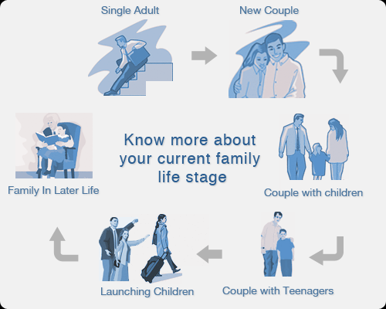

Slide 9
The changing family
Functions of the family
  Provide emotional support
  Providing economical support
  Providing child care and guidance
  Housekeeping
  Maintaining kinship
  Providing recreation

Slide 10
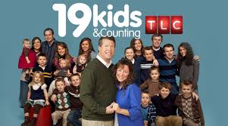
Influences of the family
  Cultural background
  Relationship
  Life-Style
  Media & Entertainment
  Technology
  Community & Society

Slide 11
Rewards & Responsibilities
Chapter 3

Slide 12
What is it like to be a Parent?
New experiences
Lifetime of a commitment
Importance of the Early Years
  Way children are brought up
  See physical growth
  Nutrition
  Setting the tone for family life & environment
  Parents are supposed to be role models
  YOU have NO choice who your parents are!

Slide 13
Once a parent, always a parent
  Caring for your child; young or old
  Each stage comes with rewards & responsibilities
  No caregiver is perfect (we all makes mistakes)

Slide 14
Rewards of Parenthood
  Joys of parenting
  Myths about parenting
    Children are sweet & loveable
    Children can strengthen a marriage
    Children provide companionship & love
    Children do not cost much money

Slide 16
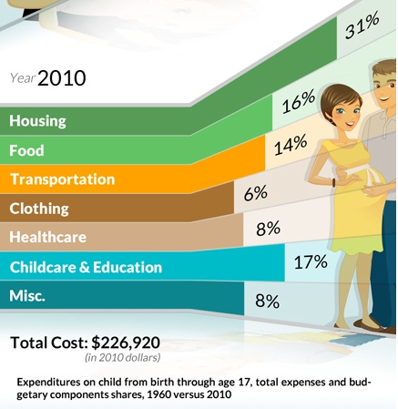

Slide 17
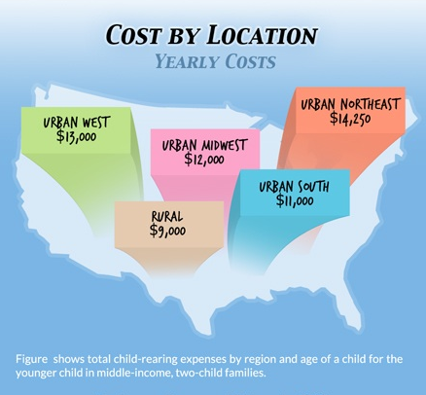

Slide 18
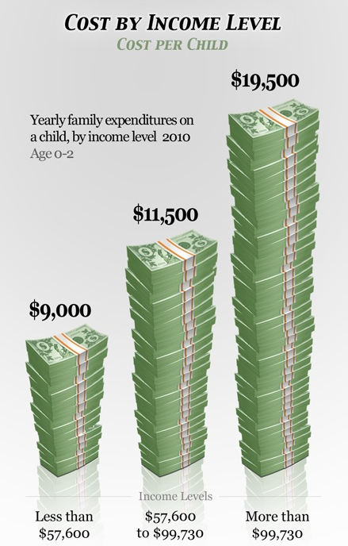

Slide 19
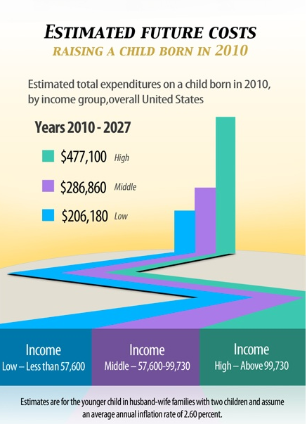

Slide 20
Responsibilities of being a parent
  Caregiver
  Nurturer
  Teacher
  Role Model
  Financial Responsibility

Slide 21
What are some long-term challenges of parenthood?

